Slide 1

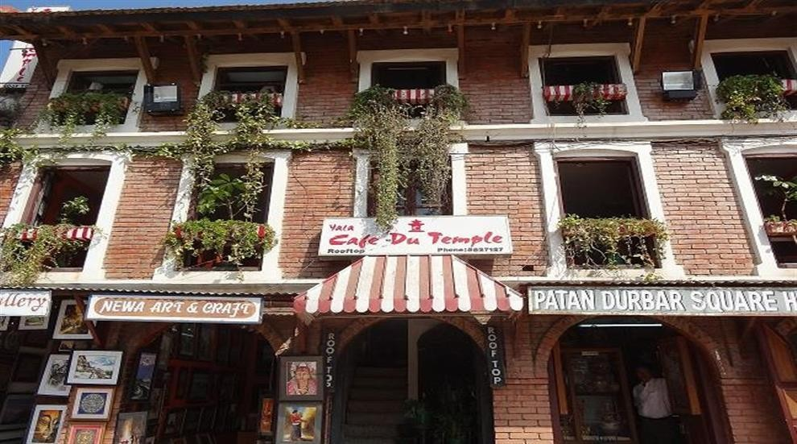
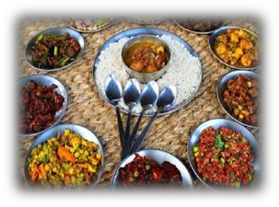
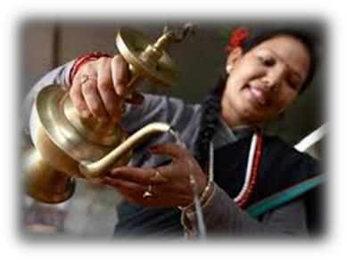
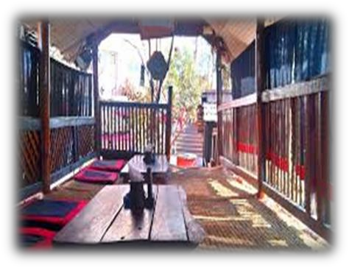
AASHAN NEWARI KITCHEN
Located at a very cultural and peaceful setting, Ashan Newari Kitchen has been bringing smile on people for ten years. With the amazing view of architectural beauty of Patan Durbar Square,
View from our restaurant
anyone would be pleased to have a break and enjoy the delicious newari cuisines.
GOOD FOOD
AASHAN NEWARI
KITCHEN
GREAT HOSPITALITY
Location: Patan, Lalitpur
Contact: 01-5520699, 01-5520733
Website: aashan@newa.com.np
PURE C ULTURAL
SETTING

Slide 2
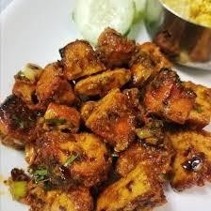
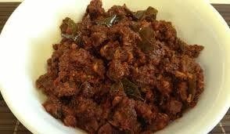
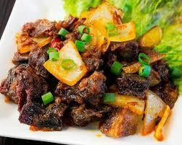
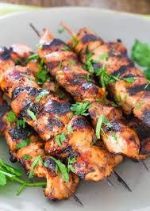
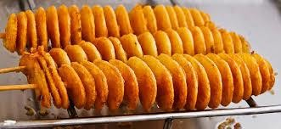
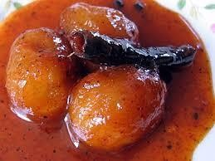
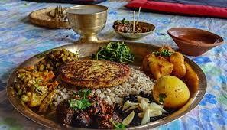
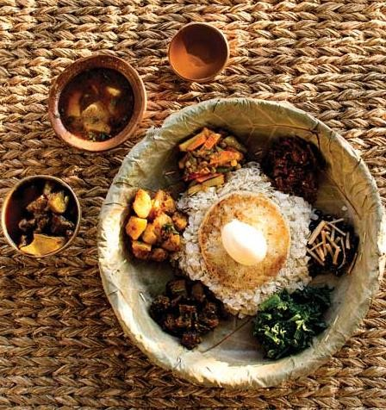
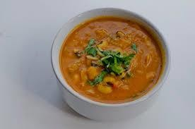
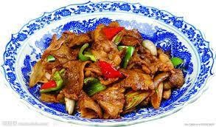
Meat dishes
Chhoila
Senlamu
Buff meat pickle
Sukuti
Sekuwa
bara
aalu
Newari 1
Newari2
Newari 3
Hamro Newari

Slide 3
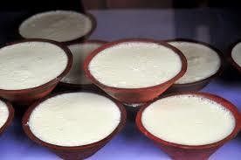
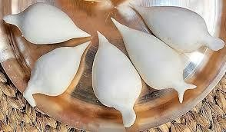
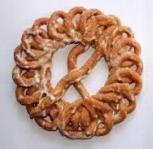
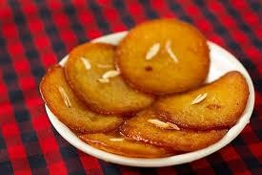
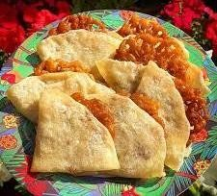
Dessert
Juju dhau
Yomari
Lakhamari
Malpuwa
Jeri Swaari

Slide 4
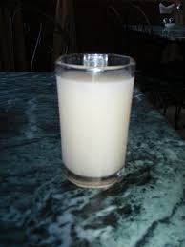
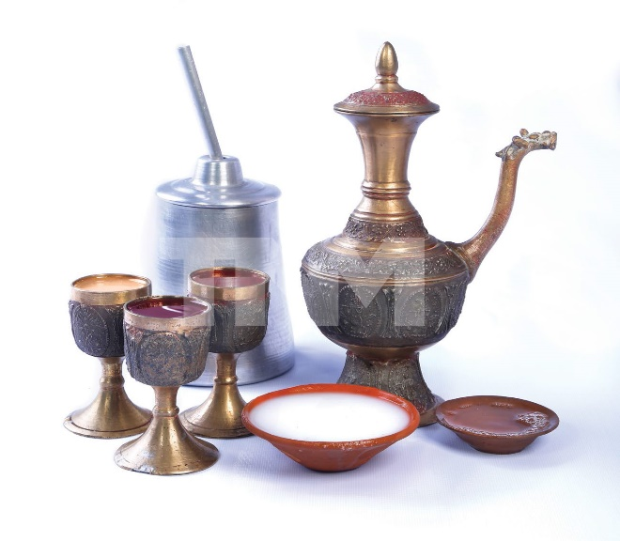
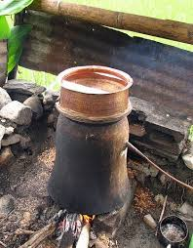
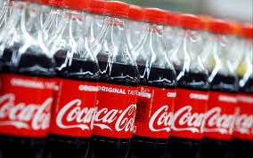
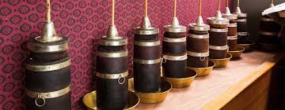
Drinks:
tinnpaane
Chyaang
Kada chyangg
Coco cola
Tumba

Slide 5
Menu
Meat dishes prices
Buff meat pickle rs400
Sekuwa rs 500
Bara rs550
Aalu dam rs600
Newari1 rs390
Newari2 rs391
Neawari3 rs399
Hamro Newari rs700
Dessert
Juju dhau rs 100
Yomari rs200
Lakhamari rs250
Malpuwa rs300
Jeri swarri rs 400
Drinks
Tinpaane rs300
Chyaang rs300
Kada chyaang rs300
Cola rs300
Tumba rs500

